Slide 1
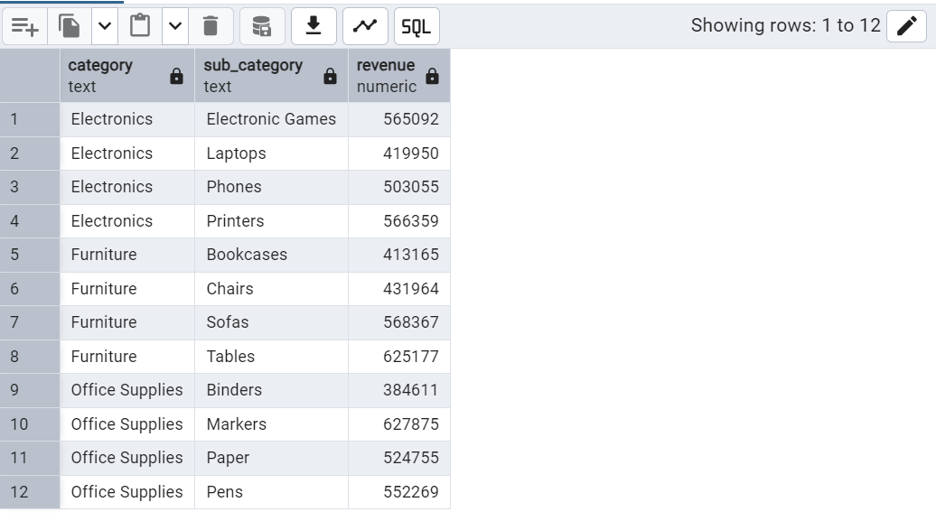
Q1.Find top 10 revenue generating products( if category and sub_category are same then assume it as same product) ?

Slide 2
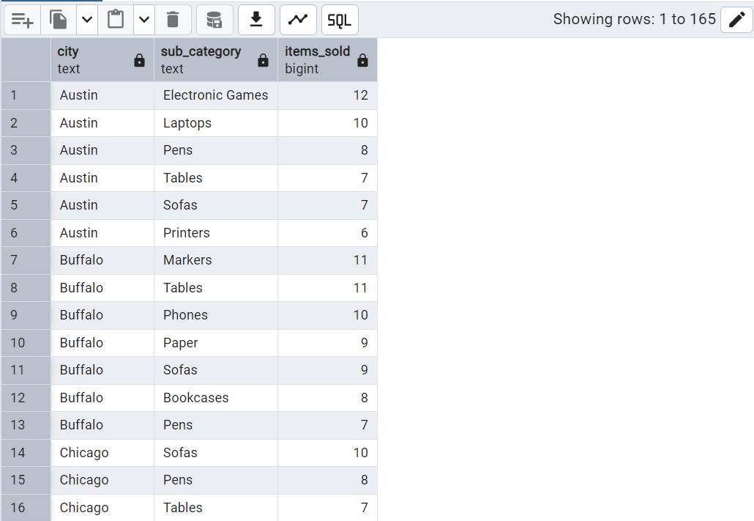
Q2. Find top 5 most selling sub_category in each city?

Slide 3
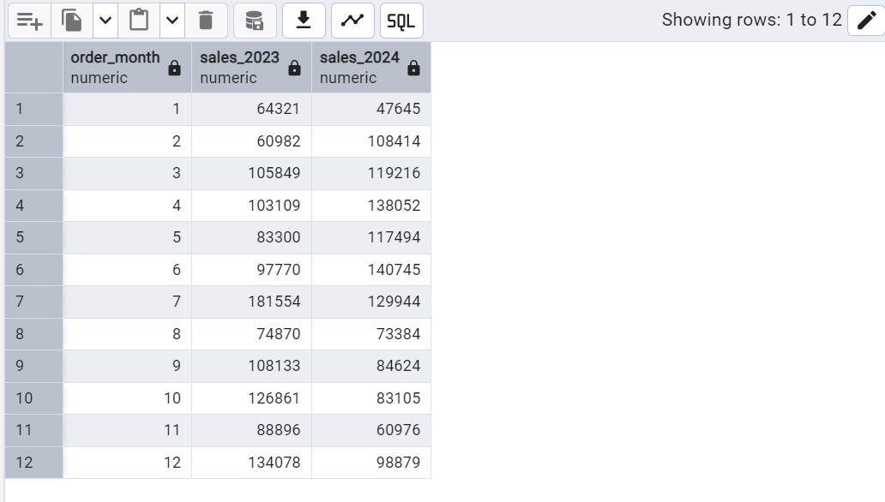
Q3. Find month over month growth comparision for 2023 and 2024 amount eg: jan 2023 vs jan 2024---(pivot using case statement)

Slide 4
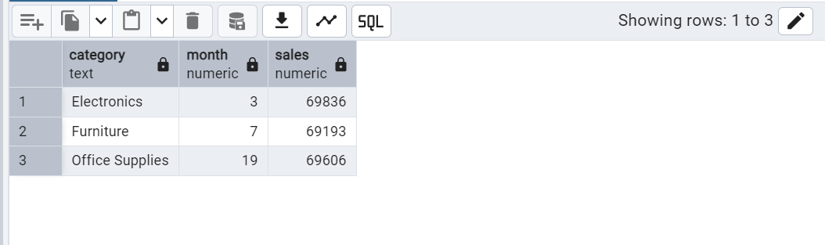
Q4. For each category which month has highest sales? (consider jan 2023 as 1st month and jan 2024 as 13th till dec 2024 as 24th month)

Slide 5

Q5. Which sub category had highest growth by profit in 2024 compared to 2023?

